Slide 1

COMP90050
Advanced Database Systems
Winter Semester, 2022
Lecturer: Farhana Choudhury (PhD)
Week 2 part 6

Slide 2
Hash Indices
A hash index organizes the search keys, with their associated record pointers, into a hash file structure. Order is not important.
Hash indices are always secondary indices.
Given a key the aim is to find the related record on file in one shot which is important.
An ideal hash function is uniform, i.e., each bucket is assigned the same number of search-key values from the set of all possible values.
Ideal hash function is random, so each bucket will have the same number of records assigned to it irrespective of the actual distribution of search-key values in the file.
Typical hash functions perform computation on the internal binary representation of the search-key.

Slide 3
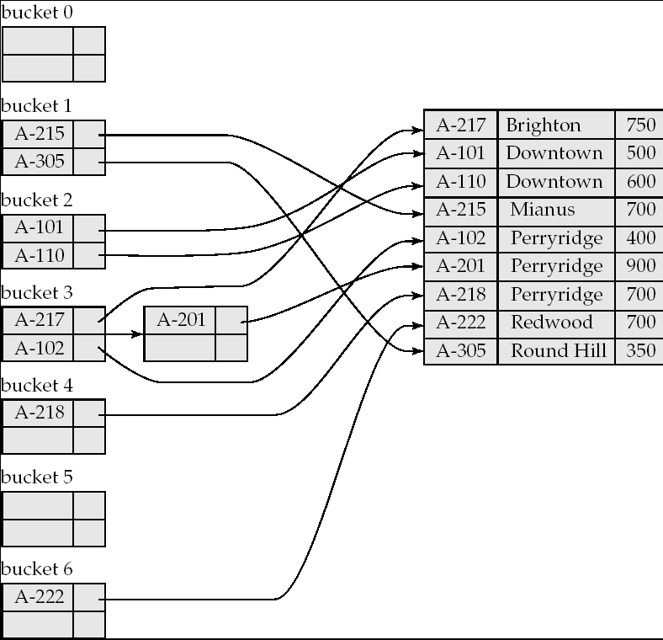
Example

Slide 4
Another example of Hash Index
hash index on attribute ID

Slide 5
Bitmap Indices
Records in a relation are assumed to be numbered sequentially from, say, 0
Applicable on attributes that take on a relatively small number of distinct values
  E.g. gender, country, state, …
  E.g. income-level (income broken up into a small number of levels such as 0-9999, 10000-19999, 20000-50000, 50000- infinity)
A bitmap is simply an array of bits

Slide 6
Example
In its simplest form a bitmap index on an attribute has a bitmap for each value of the attribute
  Bitmap has as many bits as records
  In a bitmap for value v, the bit for a record is 1 if the record has the value v for the attribute, and is 0 otherwise
  Used for business analysis, where rather than individual records say how much of one type exists is the query/important
Record Num | Name | State | Income_level
0 | John | VIC | L1
1 | Diana | NSW | L2
2 | Xiaolu | WA | L1
3 | Anil | VIC | L4
4 | Peter | NSW | L3
Bitmap for income level | Income_level
L1 | 1 0 1 0 0
L2 | 0 1 0 0 0
L3 | 0 0 0 0 1
L4 | 0 0 0 1 0
L5 | 0 0 0 0 0

Slide 7
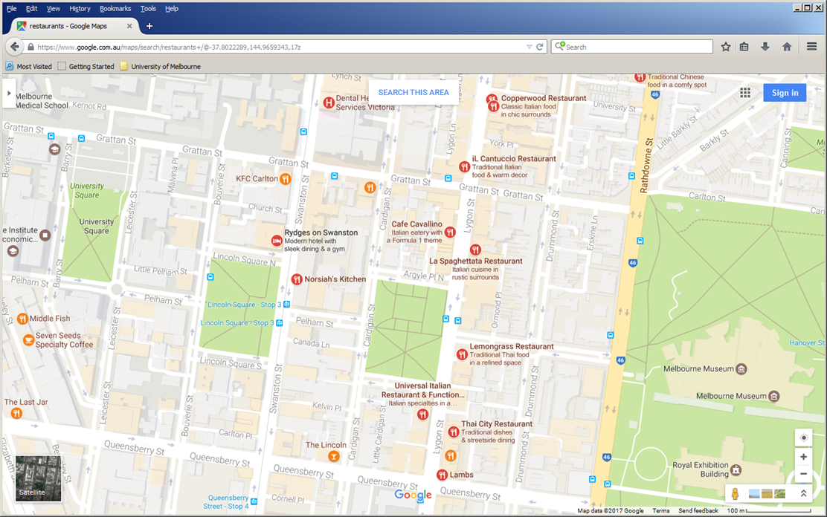
Indexing for Other Data Types
Unlike things we can access by names, ids, there is a lot of data that exists, and increasingly that requires special indexing
For example spatial data requires more complex computations for accessing data, e.g., intersections of objects in space
There is no trivial way to sort items which is a key issue, e.g., below is a common range query on a simple set of items and a Nearest Neighbor query
Q
P

Slide 8
How do we create buckets then?
In 2-d space, similar to B+trees to exponentially reduce the number of calculations by a repetitive division of space, novel indices were invented
They are in use in Oracle Spatial and other comparable DBMS extensions
The following class of data structures is one such index: Quadtrees
Q

Slide 9
But hold on where is the tree?

Slide 10
How to run a NN query?
Q
Basically the same approach, as any other tree does, e.g., Best First Search
Just order access with respect to distance to point

Slide 11
More on Quadtrees
Each node of a quadtree is associated with a rectangular region of space; the top node is associated with the entire target space.
Each division happens with respect to a rule based on data type.
Each non-leaf nodes divides its region into four equal sized quadrants
  Thus each such node has four child nodes corresponding to the four quadrants and division continues recursively until a stopping condition
Example: Leaf nodes have between zero and some fixed maximum number of points (set to 1 in example below)

Slide 12
R-Trees
R-trees are an N-dimensional extension of B⁺-trees, useful for indexing sets of rectangles and other polygons.
Supported in many modern database systems, along with variants like R⁺ -trees and R*-trees.
Basic idea: generalize the notion of a one-dimensional interval associated with each B+ -tree node to an N-dimensional interval, that is, an N-dimensional rectangle.
Will consider only the two-dimensional case (N = 2)
  generalization for N > 2 is straightforward, although R-trees work well only for relatively small N
  Bounding boxes of children of a node are allowed to overlap
Note: A bounding box of a node is a minimum sized rectangle that contains all the rectangles/polygons associated with the node

Slide 13
Example R-Tree
A set of rectangles (solid line) and the bounding boxes (dashed line) of the nodes of an R-tree for the rectangles.
The R-tree is shown on the right.
The clustering of objects are based on a rule.

Slide 14
Search in R-Trees
To find data items intersecting a given query point/region, do the following, starting from the root node:
  If the node is a leaf node, output the data items whose keys intersect the given query point/region.
  Else, for each child of the current node whose bounding box intersects the query point/region, recursively search the child.
Can be very inefficient in worst case since multiple paths may need to be searched due to overlaps, but works acceptably in practice.

Slide 15
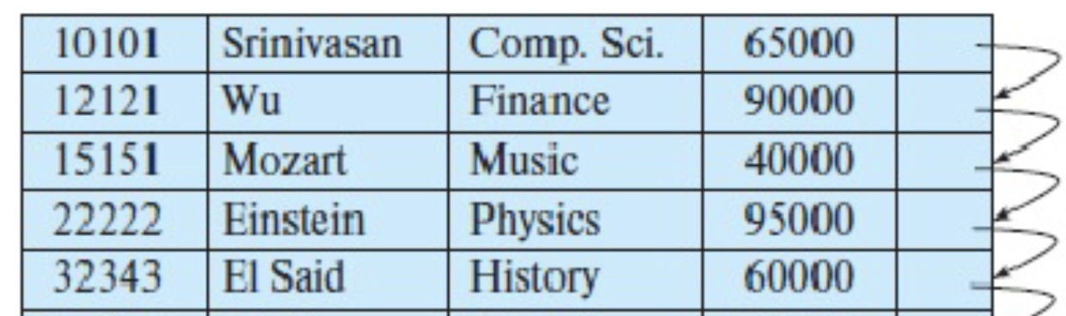
Using indexes
Some indexes are automatically created by the DBMS
  - For UNIQUE constraint, DBMS creates a nonclustered index.
  - For PRIMARY KEY, DBMS creates a clustered index
You can create indexes on any relation (or view)
Source: https://docs.microsoft.com/en-us/sql/t-sql/statements/create-spatial-index-transact-sql?view=sql-server-ver16

Slide 16
Index Definition in SQL
Create an index
  create index <index-name> on <relation-name>
  (<attribute-list>)
To drop an index
  drop index <index-name>
Most database systems allow specification of type of index, and clustering

Slide 17
Index Definition in SQL
1. Create a clustered index on a table
    CREATE CLUSTERED INDEX index1 ON table1 (column1);
  2. Create a non-clustered index with a unique constraints
    CREATE UNIQUE INDEX index1 ON table1 (column1 DESC, column2 ASC, column3 DESC);
    (A unique index is one in which no two rows are permitted to have the same index key value)

Slide 18
Index Definition in SQL
Specialized indexes
Filtered index
CREATE INDEX index1 ON table1 (column1)
WHERE Year > ‘2010’;
(A filtered index is an optimized nonclustered index, suited for queries that select a small percentage of rows from a table. It uses a filter predicate to index a portion of the data in the table)
Spatial index
CREATE SPATIAL INDEX index_name ON table_name(Geometry_type_col_name) WITH ( BOUNDING_BOX = ( 0, 0, 500, 200 ) );

Slide 19
What you need to do now?
There is no point going through all index types for all data types
  There is hundreds of them
  Even each type would have many subtypes
    E.g., MX-CIF quadtree is one quadtree type among many
  Same with R-trees, etc
  Same with many other index types
Given a data set, when uploading to the DBMS
  Find the potential query types
  Research what indices that particular DBMS would have for that data type
  Research for what queries you would better do on what index
  Create index if you have large data
  Monitor performance
  Tune or create other indices
  Your DMBS will have a version of the “create index” SQL statement

